Slide 1

Business Development New Ice Cream shop venue – A Report
Raghunath Nair
IBM

Slide 2
Introduction
A Business development consultant has been tasked to make recommendations to a Venture Capitalist on opening a new Ice Cream shop in Bangalore.
The client would like a neighbourhood with other Indian Restaurants, but a location having not much competition in the area
The project provides an exploratory data analysis and visualizations to eventually come to a recommended location(s).

Slide 3
Data
The data to be used for this project consists the Foursquare location data for the City of Bangalore. More precisely the dataset would use the following features for exploratory data analysis and necessary machine learning involved.
Neighbourhood, Neighbourhood Latitude, Neighbourhood Longitude, Venue, Venue Latitude, Venue Longitude, Venue Categories

Slide 4
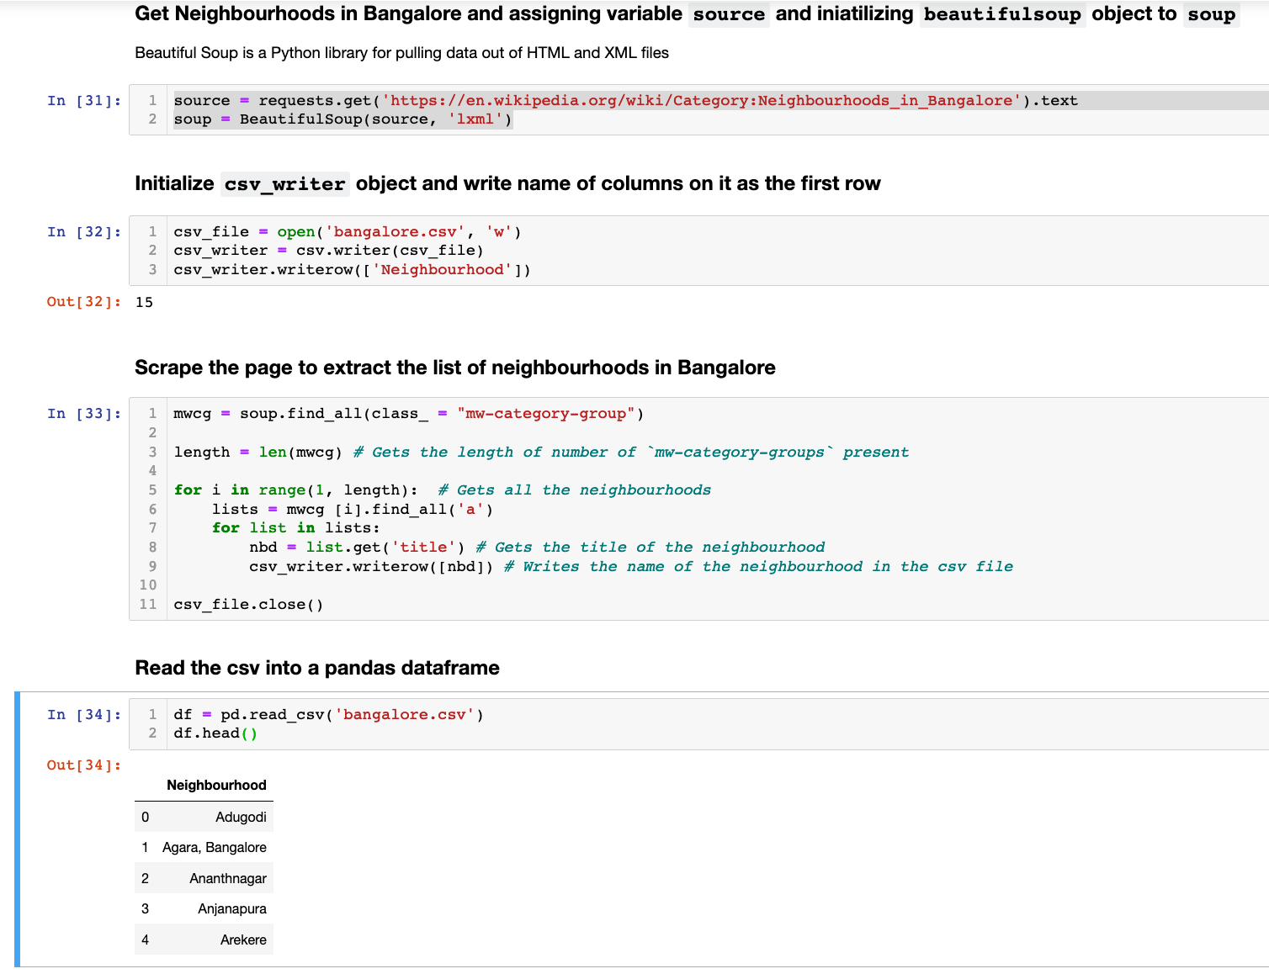
Methodology
Get Neighbourhoods in Bangalore and assign variable source and initializing beautifulsoup object to soup. Beautiful Soup is a Python library for pulling data out of HTML and XML files.
128 neighbourhoods were retrieved by the API

Slide 5
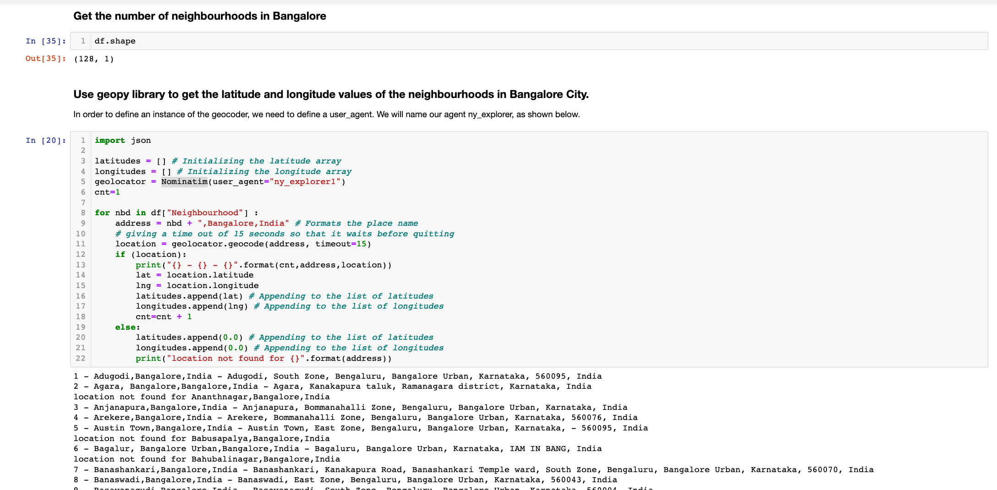
Methodology
Get coordinates for each neighbourhood
Use GEOPY library to get the latitude and longitude values of the above neighbourhoods in Bangalore City

Slide 6
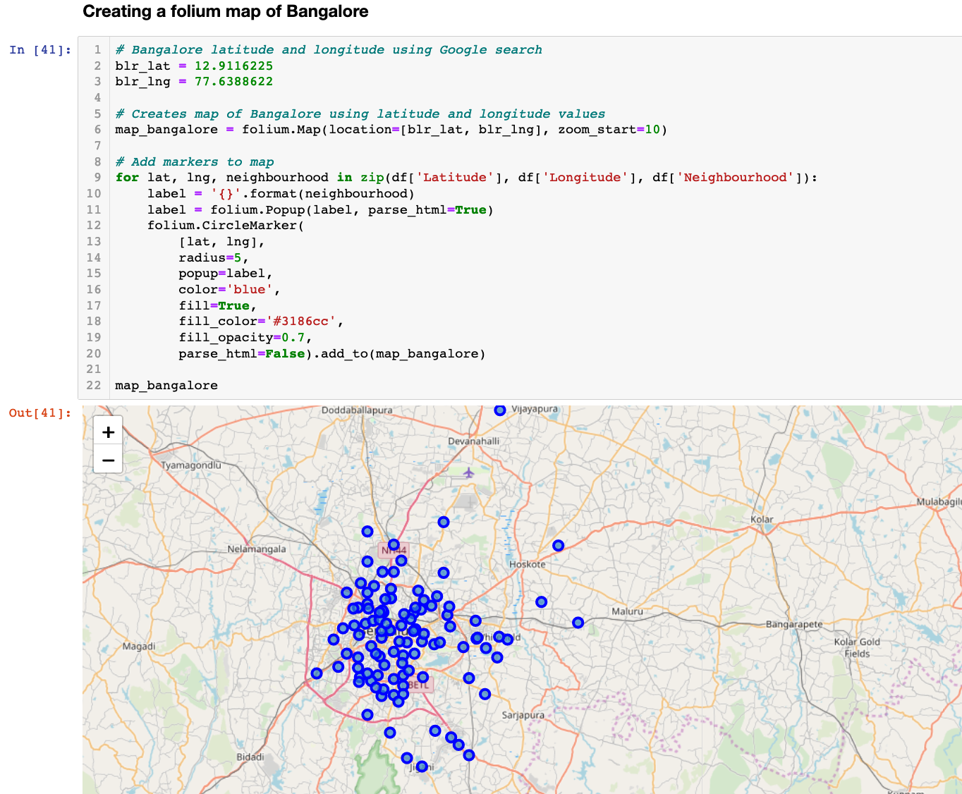
Methodology
Visualize using Folium
It makes sense to visualize the datasets at each stage of the data wrangling as it could stimulate new ideas and provide different perspectives. Then we create a map of Bangalore using latitude and longitude values

Slide 7
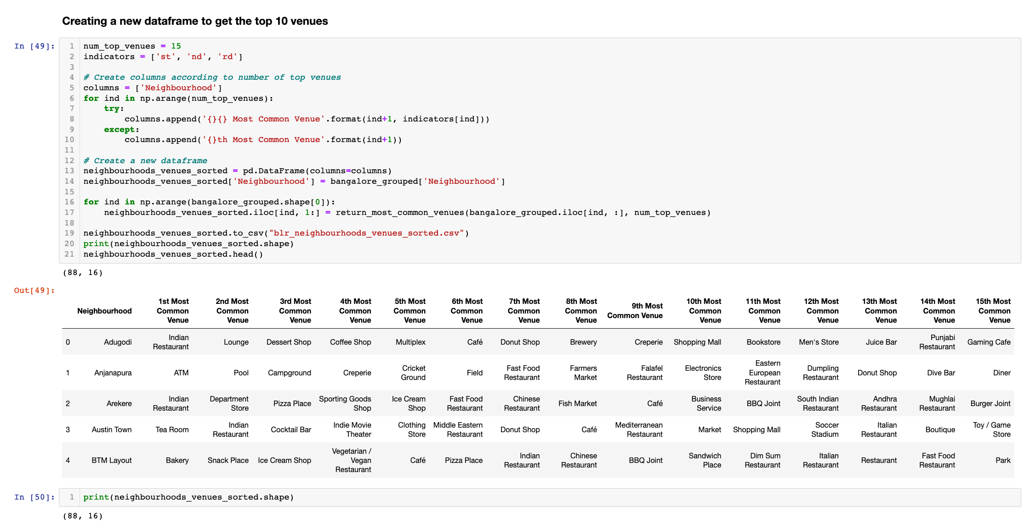
Methodology
Top 10 most venue categories
Use the foursquare APIs to get the nearest X venues and venue categories, which will be used for clustering the neighbourhoods. Since there are so many venue categories, only Top 15 were chosen for this exercise

Slide 8
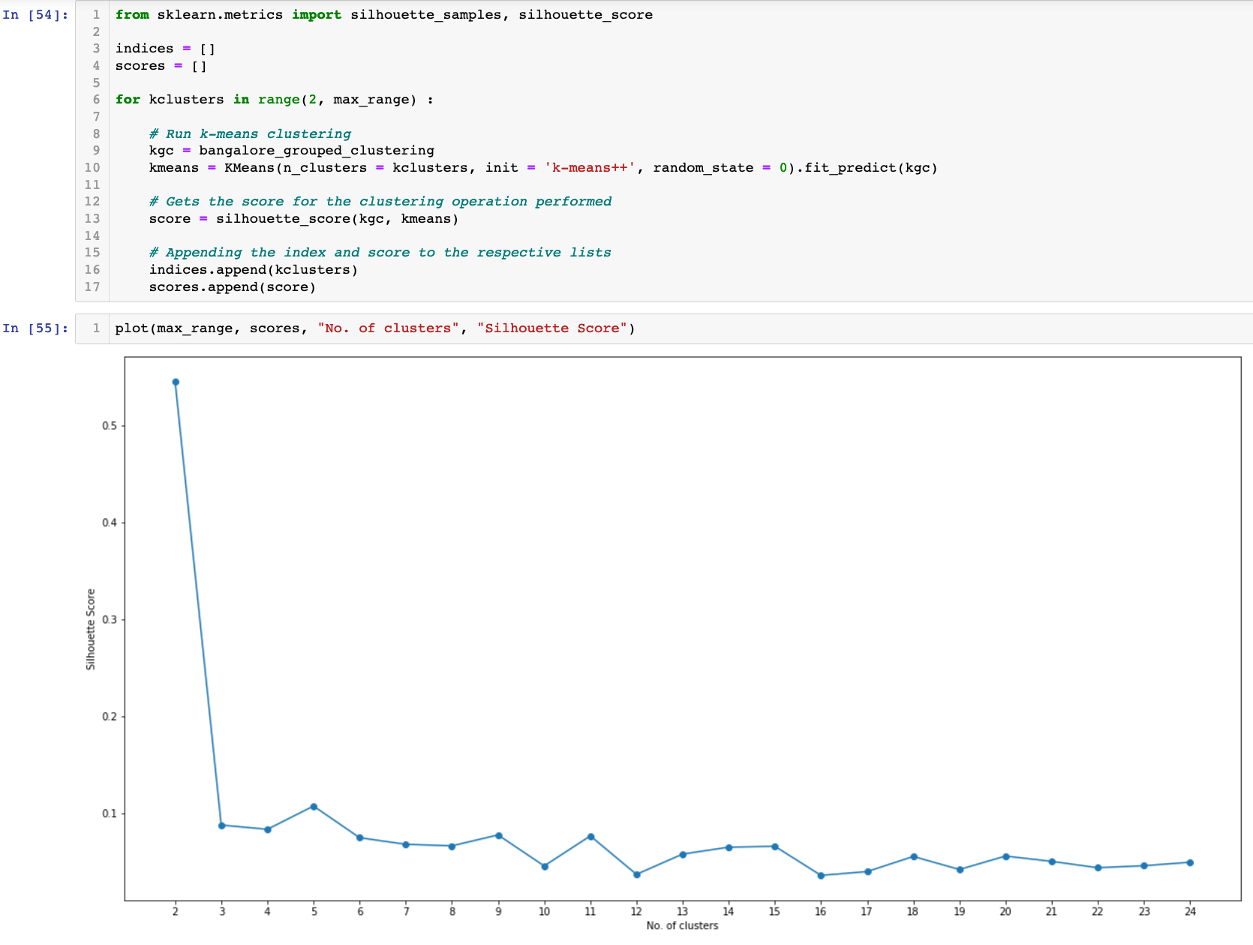
Methodology
Optimal number of clusters
The optimal number of clusters is found out by the silhouette score whose value is a measure of how similar an object is to its own cluster (cohesion) compared to other clusters (separation). The silhouette ranges from −1 to +1, where a high value indicates that the object is well matched to its own cluster and poorly matched to neighbouring clusters.

Slide 9
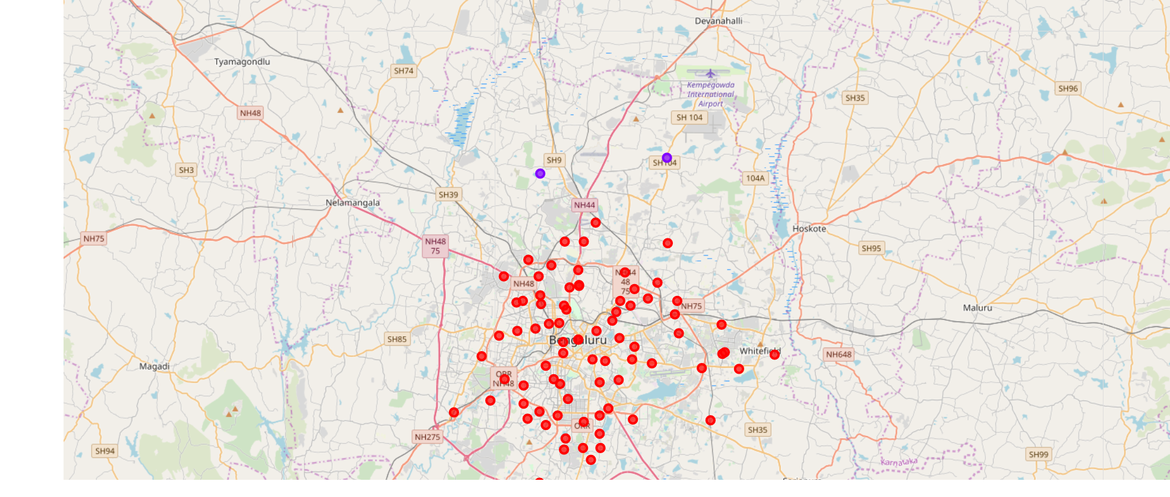
Methodology
K-means clustering
The Bangalore neighbourhoods and venue data is trained using K-means Clustering Algorithm to get the desired clusters to base the analysis on.
K-means was chosen since the variables(categories in this case) are large, the K-Means most of the times is computationally faster.
From the above clustering, we can see that majority of the clusters are falling under the same cluster (cluter1) with most common venue being eateries('Indian Restaurant', 'Kerala Restaurant' etc), apart from the remote areas like Bagalur, Ramagondanahalli etc.

Slide 10
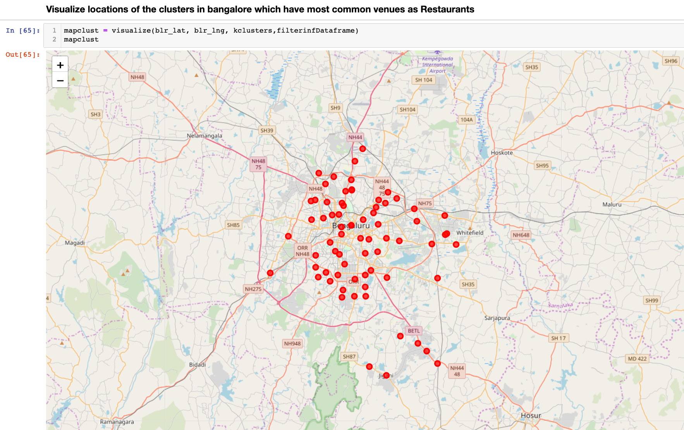
Methodology
Narrowing Down
Subsequently we narrow down the cluster step-by-step to just a few points based on certain conditions like, the venue should have restaurants as common venue

Slide 11
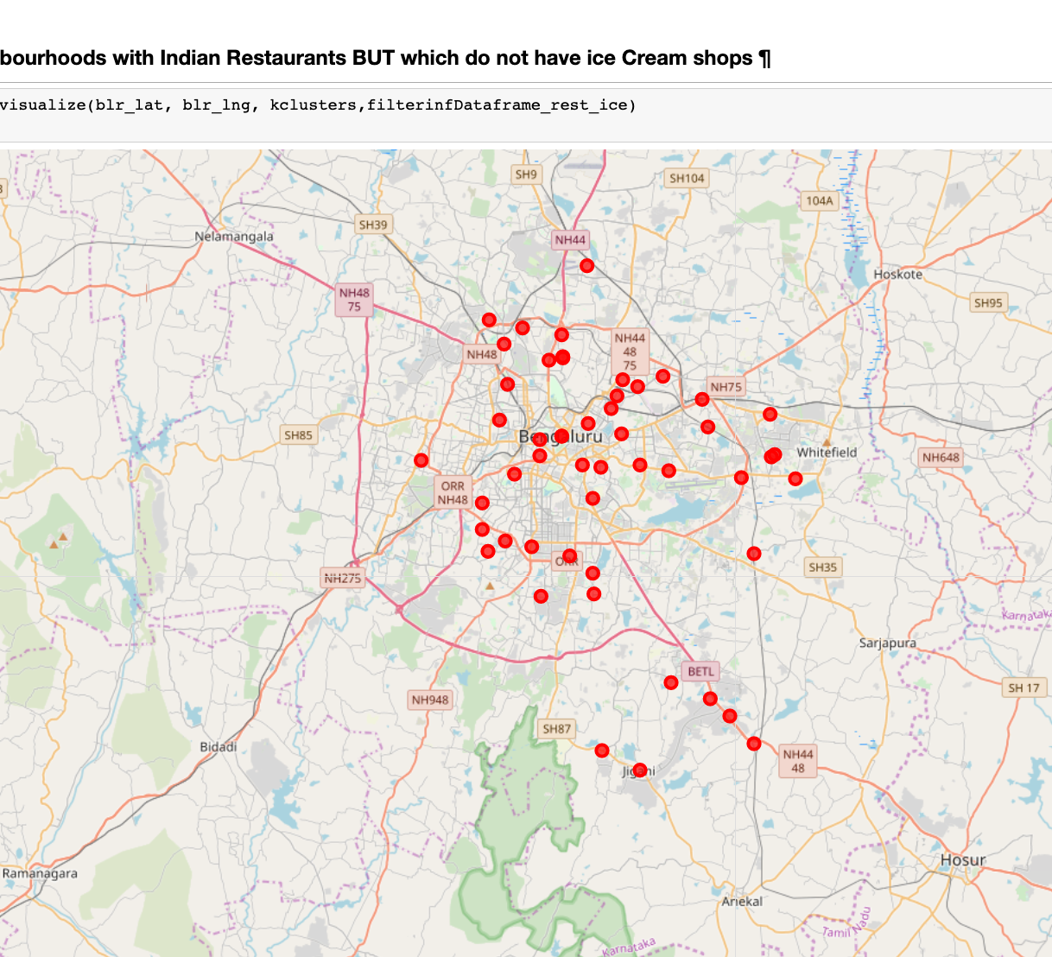
Methodology
Narrowing Down
Subsequently we narrow down the cluster step-by-step to just a few points based on certain conditions like, the venue should have restaurants but not many ice cream parlours

Slide 12
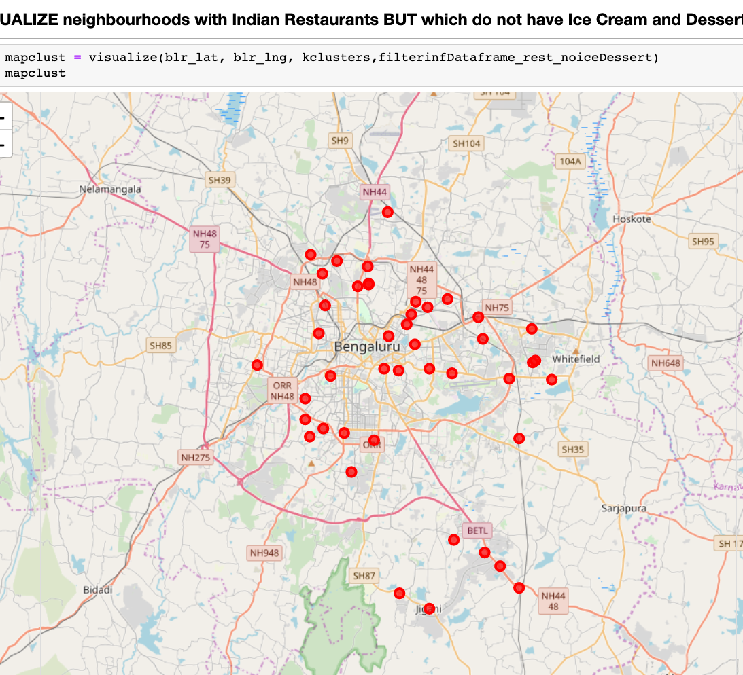
Methodology
Narrowing Down
Subsequently we narrow down the cluster step-by-step to just a few points based on certain conditions like, the venue should have restaurants but not many ice cream parlours and desserts in its vicinity

Slide 13
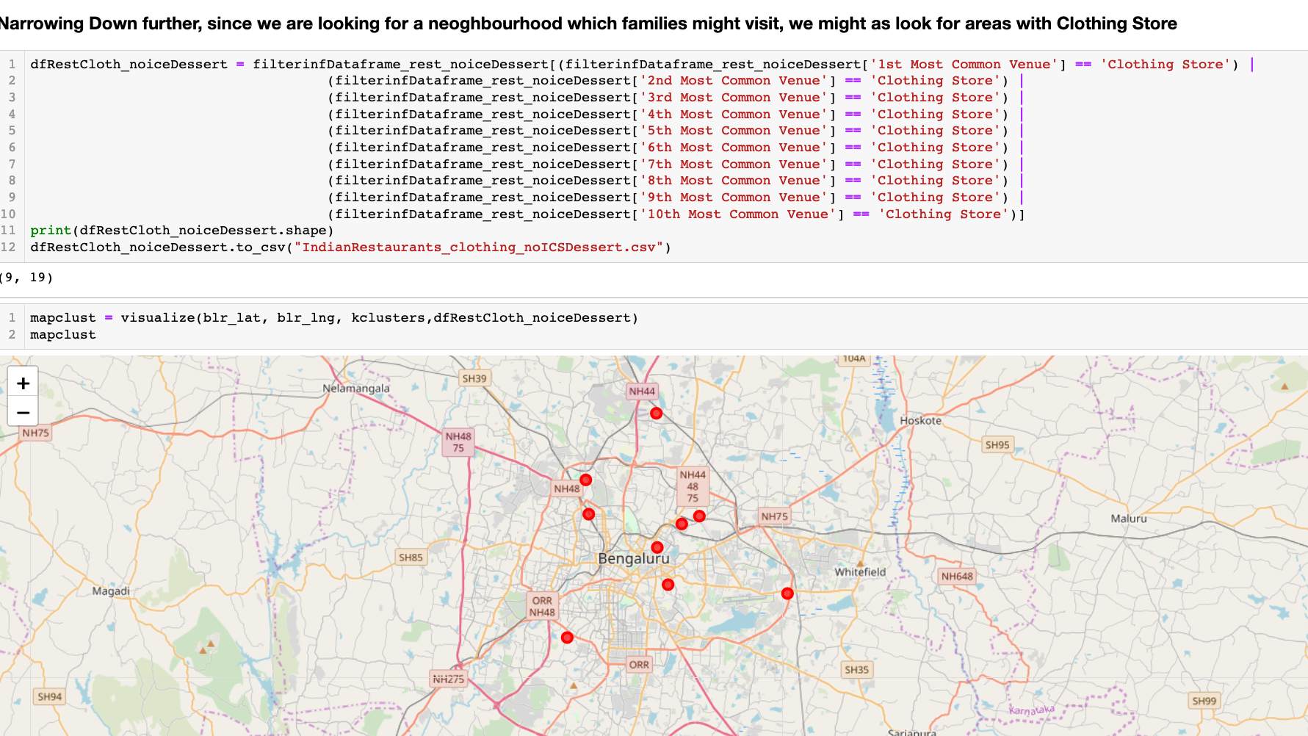
Methodology
Narrowing Down
Narrow down further the cluster to just a few points.
Since we are looking for a family spot, applying filter for venue to be near clothing stores.
As can be seen the choice is narrowing down

Slide 14
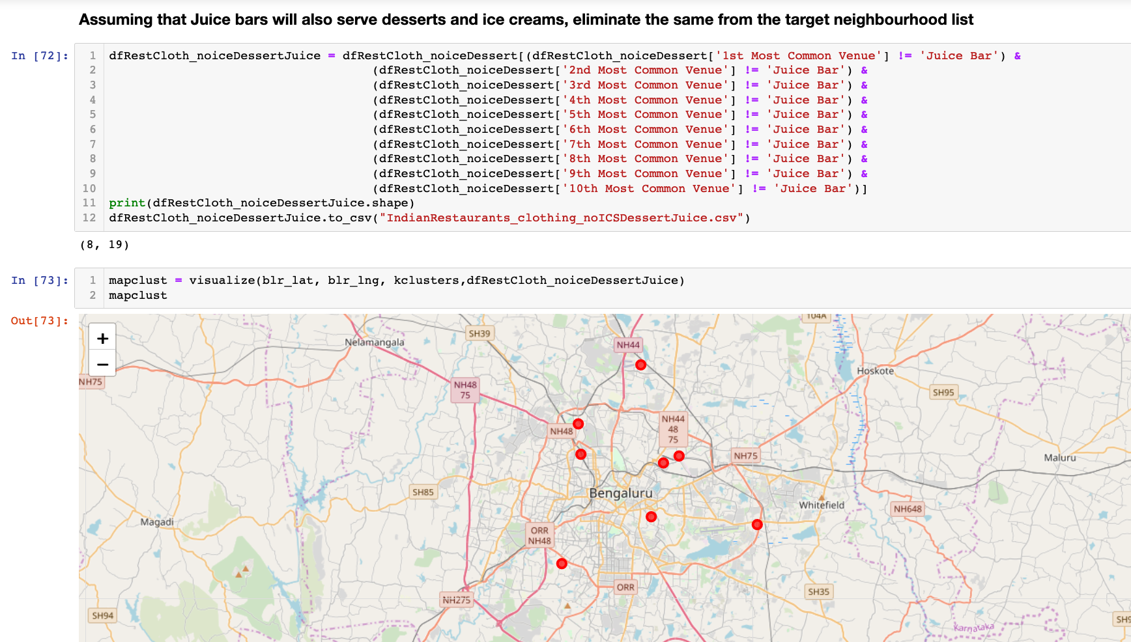
Methodology
Narrowing Down the cluster further, assuming Juice bar also serve as desserts or ice creams, we eliminate them as well
As can be seen the choice is down to just 8 locations

Slide 15
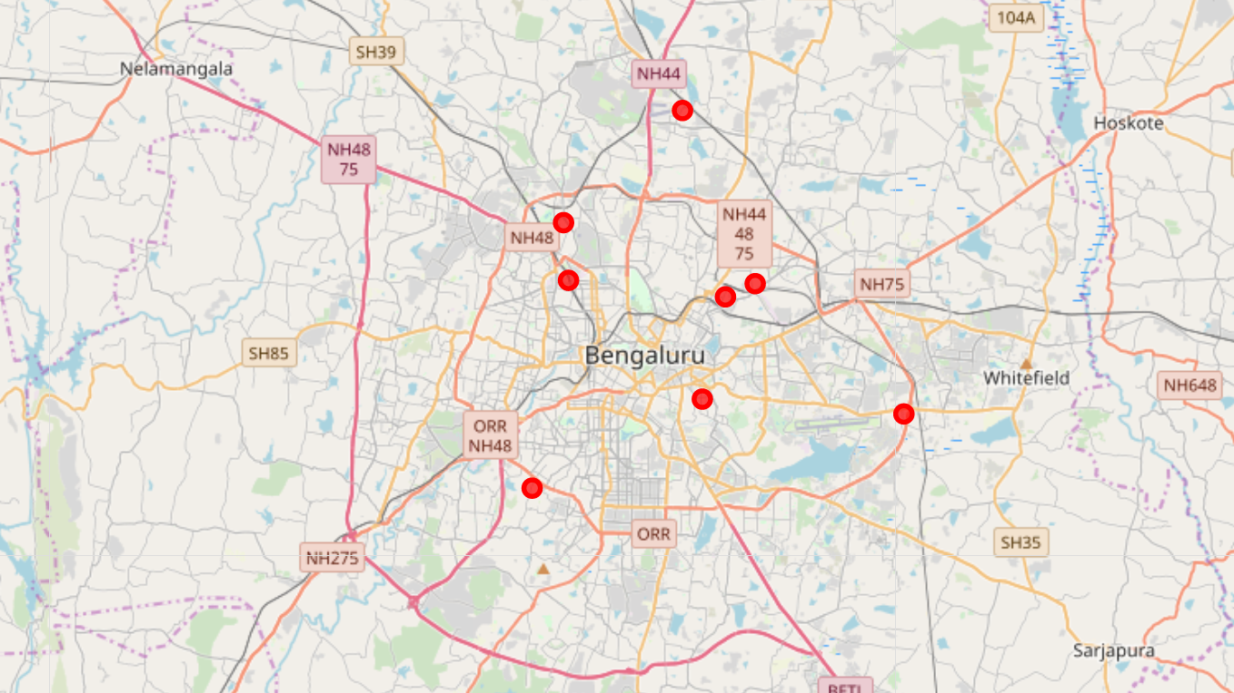
Results
To find an Ice cream storefront site accessible from main roads, with easy access, and with sufficient customer parking, we need to look for locations near businesses, like children’s clothing stores or Indian restaurants.
To narrow down our search and visualize at each step helps the Stakeholders to make business decisions as per company strategy
On applying the filter conditions we can see that the target locations meeting the required conditions were narrowed down to just 8

Slide 16

Discussion
From the exploratory analysis, clustering and filtration process based on venue categories, we see that there are lots of neighbourhoods which have Restaurants among the top 10 venues.
However we found from the above exercise that localities where we have Restaurants and clothing Stores as most common venues, BUT which do not have ice cream shops, desserts or juice bars are very few.
This entire process provides interesting insights into the problem allowing stake holders to make easier decision making which are aligned to the business strategy

Slide 17
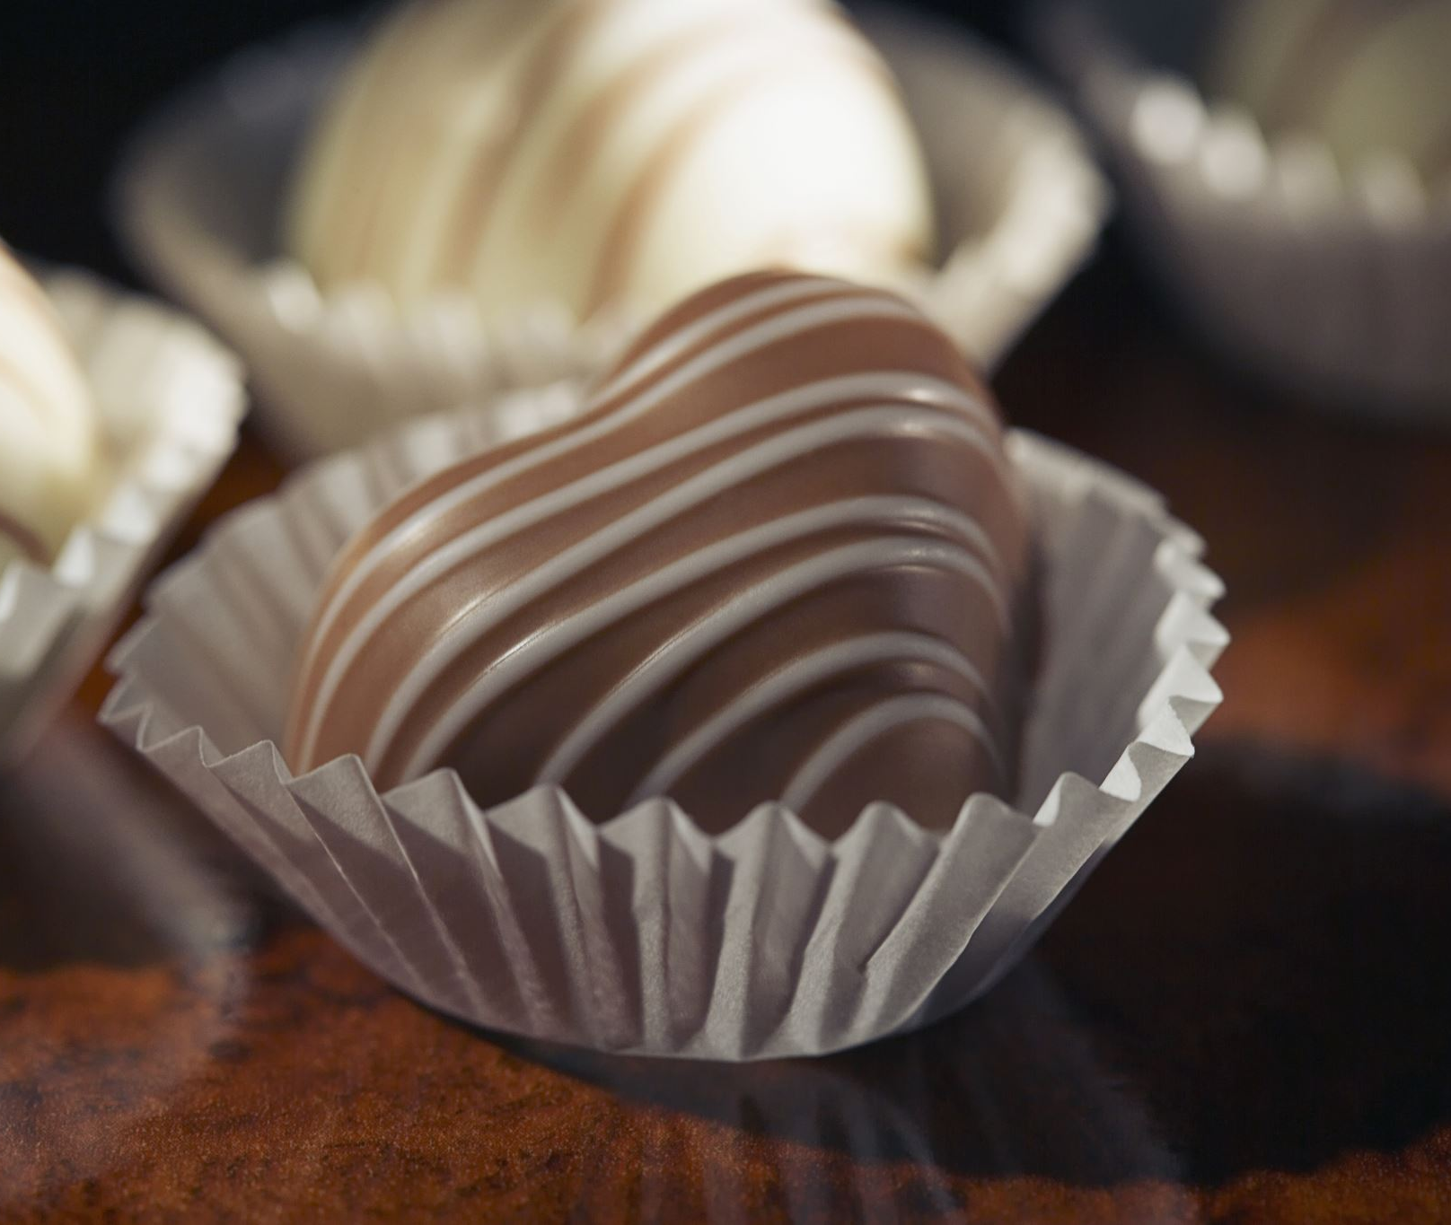
Conclusion
A possible recommendation could bee that - since Jakkur is emerging as an upcoming residential property market and not reached full potential, this could possibly be a good candidate for opening an Ice cream shop, and it also meets all the necessary conditions.

Slide 18

Reference
https://github.com/raghunath-nair/Coursera_capstone_W4

